Slide 1
Kent & Medway Pathology Network LIMS Implementation: LIMS contract and High Level Plan Thursday 24th February 2022 at 1pm
Kent and Medway Pathology Network
Transforming health and social care in Kent and Medway is a partnership of all the NHS organisations in Kent and Medway, Kent County Council and Medway Council.
We will work together to make health and wellbeing better than ant partner can do alone.

Slide 2
Nicola West, LIMS Project Director Nicola.west4@nhs.net 07955 436200 Delphine Barraclough, Business Change Manager delphine.barraclough1@nhs.net 07732 406536
Kent and Medway Pathology Network
Transforming health and social care in Kent and Medway is a partnership of all the NHS organisations in Kent and Medway, Kent County Council and Medway Council.
We will work together to make health and wellbeing better than ant partner can do alone.

Slide 3
What we’ll cover today
What is the LIMS project
Background on the LIMS contract
What is the CliniSys LIMS project process
Project milestones
Harmonising processes & tests

Slide 4
LIMS Project scope
Laboratory Information Management System (LIMS)
LIMS for 4 Trusts, 3 Pathology services, 7 labs
CliniSys Winpath Enterprise
Single harmonised LIMS
Joint design across all of Kent & Medway

Slide 5
LIMS contract dates
Agreement was signed (Execution date): 8th February 2022
Contract ends: 7th February 2035 (3 year build + 10 year service)
MTW Planned Operational Service Commencement Date:
1st Nov 2023
EKHUFT Planned Operational Service Commencement Date:
1st July 2024
NKPS Planned Operational Service Commencement Date:
1st Jan 2025

Slide 6
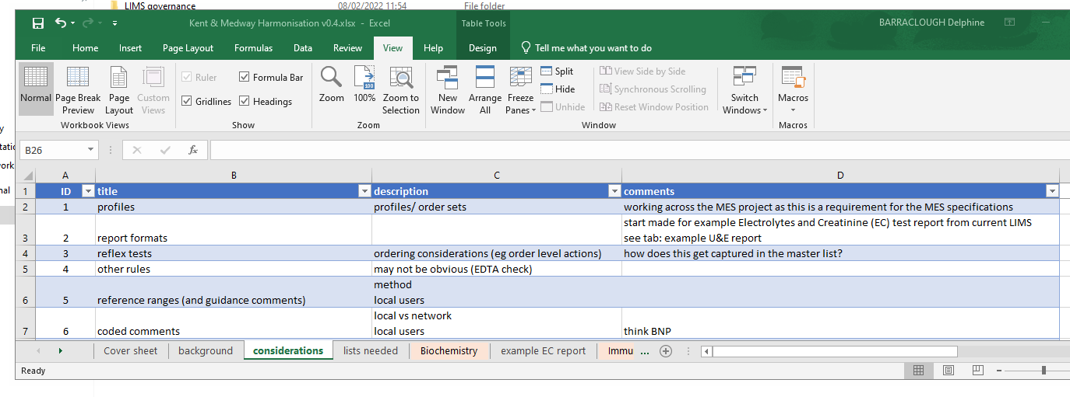
Kent & Medway pathology harmonisation
How do we get ready for LIMS?
Process harmonisation
Test code catalogue

Slide 7
Kent & Medway pathology harmonisation
What do pathology teams need to be thinking about and doing?
Asking their managers
Share information about potential ‘pinch-points’ across the other transformation projects
Reading LIMS newsletters
Forum for all pathology staff to share: experiences; ideas; opportunities
Process improvement now
Supporting the pathology network transformation
Reach out to the Business Change Team

Slide 8
Project Process
Approx. dates
Project Initiation – includes project Kick Off, Operational Solution Design
High Level Design (HLD) – workflow design split by workstream.
Discipline specific, solution, analyser integration, IT integration
Testing – the build and the process
Low Level Design (LLD) – refining and building the HLD workflow in Winpath
Training
Mar- April 2022
April - Sept 2022
Oct 22 - Apr 23
May 2023 onwards
Jul 2023 onwards

Slide 9
LIMS next steps (indicative dates)
Project Initiation:
Project kick off meeting: w/c 7th March
Operational Solution Design (OSD) face to face meetings: w/c 7th & 21st March
Pathology discipline leads meet CliniSys leads: w/c 14th March
Project Documentation drawn together (PID): March
Operational Solution Design signed off: April
High Level Design workshops: end April to September 2022
Discipline HLD’s x 4
Solution HLD
Integration (analyser) HLD
IT Integration

